Slide 1

Depth phase at regional distance
Week six summary: Download data and processing
Li Tianjue 2022, 02

Slide 2
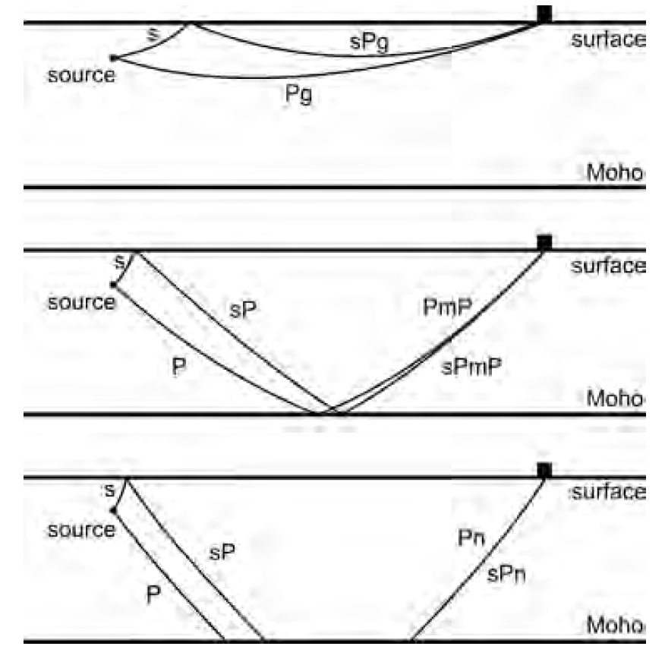
Regional depth phases (sPg, sPmP and sPn):
(1) sPg the S-wave travels upward to the surface, is converted to a P-wave at the critical angle, then the P-wave travels along or close
the surface to the station;
(2) sPmP the S-wave travels upward to the surface, is converted to a P-wave, then the P-wave travels downward to the Moho, is reflected there and travels upward to the station;
(3) sPn the S-wave travels upward to the surface, is converted to a P-wave, then the P-wave travels along the Pn path to the station.
Ma, 2012

Slide 3
Summary I:
On regional waveform records, one or more phases are well developed between the first arrivals (Pg or Pn) and the S-wave train, and one or two of them are regional depth phases:
Within about 100 km, the sPg phase is well developed on some records of earthquakes as small as M~1.5.
In the distance window from about 200 to 300 km, the sPmP phase is well developed on some records of earthquakes as small as M~2.0;
Beyond 300 km, the sPn phase is developed on some records of moderate and sub-moderate earthquakes.
Ma, 2012

Slide 4
Umino et al., 1995
Summary II:
Many shallow earthquakes occur in and around the seismic network, and a remarkable later phase sP is often observed at small epicentral distances of about 150 km or so from those small events (M~3) with focal depths from about 40 km to 90 km. This phase appears between the P- and S-wave arrivals and characteristics of the phase are as follows.
The sP phase is predominantly observed on the vertical component of seismograms;
(2) The direction of wave approach is almost the same as that for the direct P phase;
(3) The apparent velocity of the sP phase is slower than that of the direct P phase and faster than that of the direct S phase;
(4) The predominant period of the sP phase is slightly longer than that of the direct P phase and is nearly the same as that of the direct S phase;
(5) The amplitude of sP phase varies from event to event, ranging from about 50 to 200 per cent of that of the direct P
phase;
(6) The sP phase is clearly observed not only at some particular stations but at many stations widely distributed in space.

Slide 5
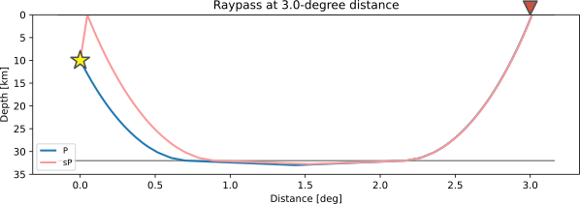
Traveltime Curve of Depth Phase

Slide 6
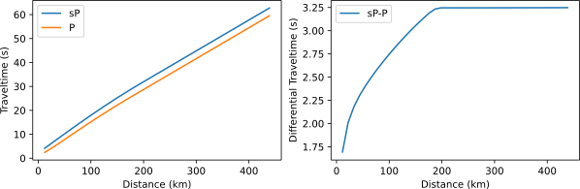
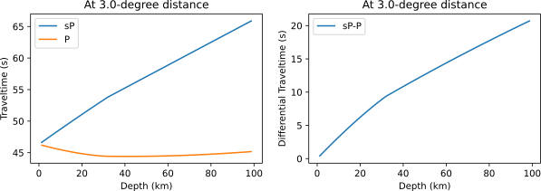
Traveltime Curve of Depth Phase

Slide 7
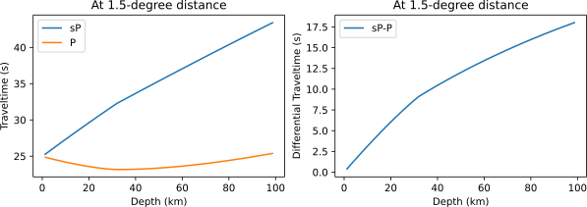
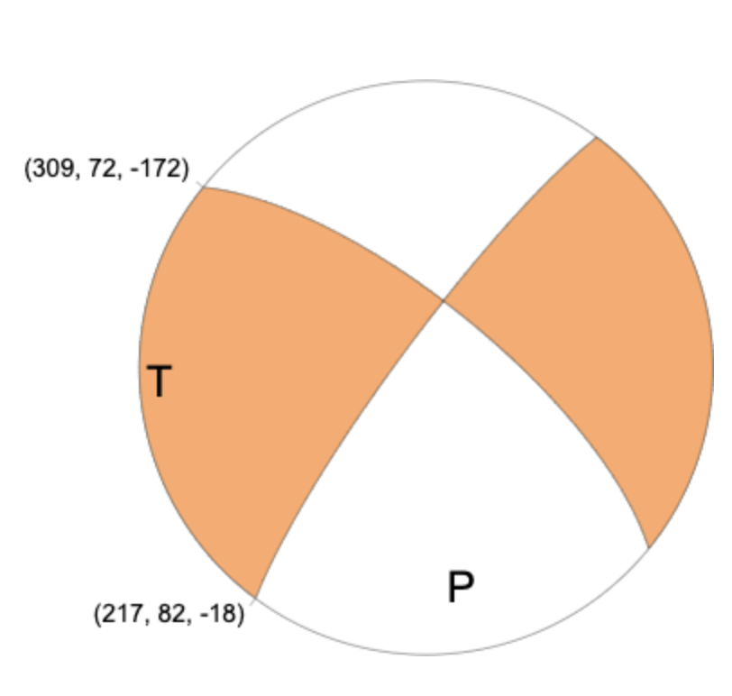
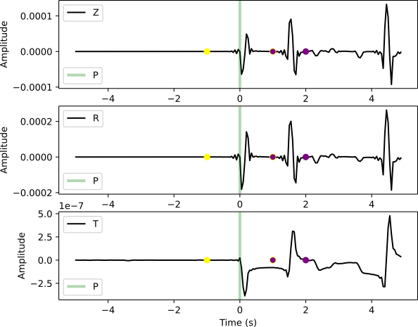
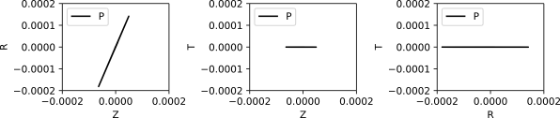
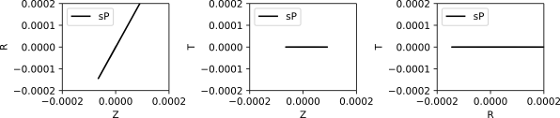
Particle Motion of Depth Phase

Slide 8
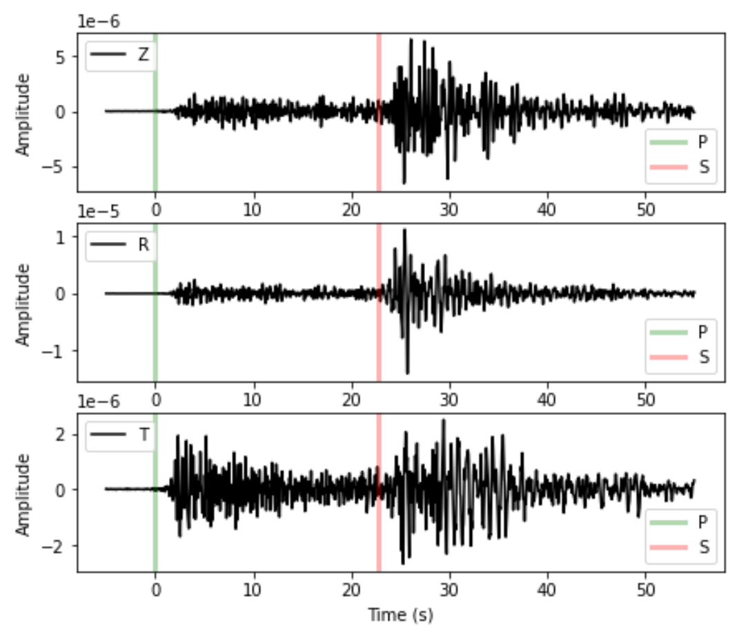
Download Waveform and Mark the P- and S-wave Arrivals
### station info: CI.MTG, 33.19915,-116.64727,1092m https://service.scedc.caltech.edu/SCSNStationMap/station.html
### event info: M 3.5 - 23km NW of Ludlow, CA 2020-11-17 17:32: 32(UTC)34.862°N 116.340°W 5.3 km depth https://earthquake.usgs. gov/earthquakes/eventpage/ci39468407/executive

Slide 9

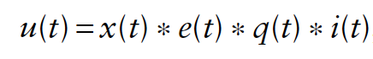
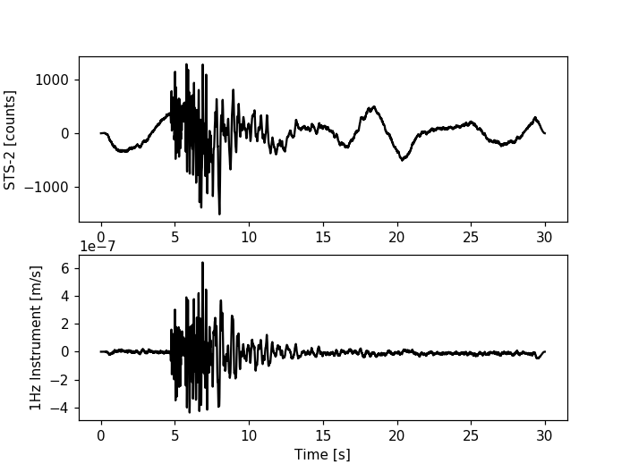
Mass Download Waveform and Data Preprocessing
Remove the instrument response
where x(t) is the source time function, the “signal” the earthquake puts into the ground, e(t) and q(t) represent the effects of earth structure, and i(t) describes the instrument response of the seismometer.
Resample and filter waveforms
Mark the P-wave traveltime on waveforms
Select waveforms according to signal-to-noise ratio

Slide 10
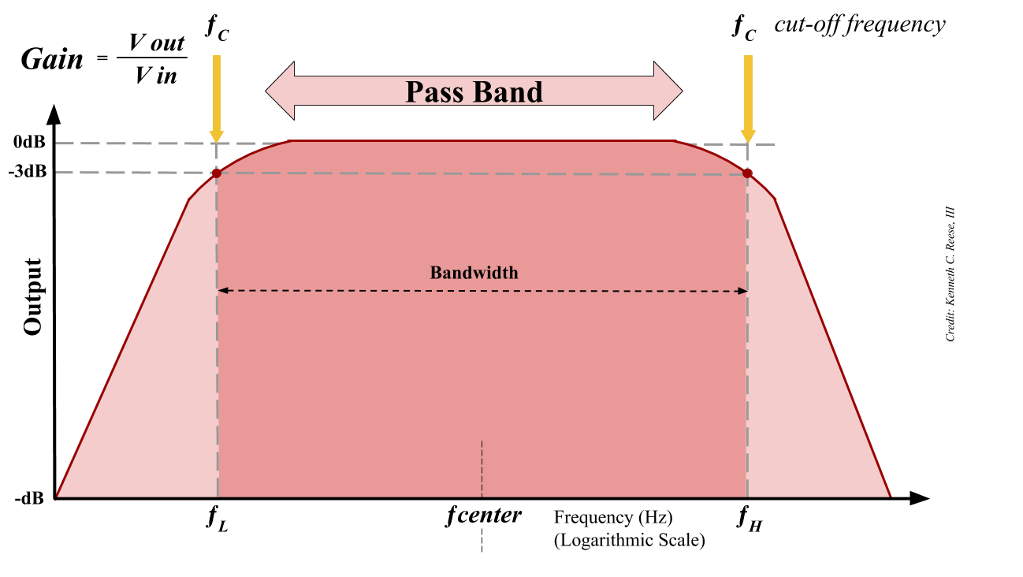
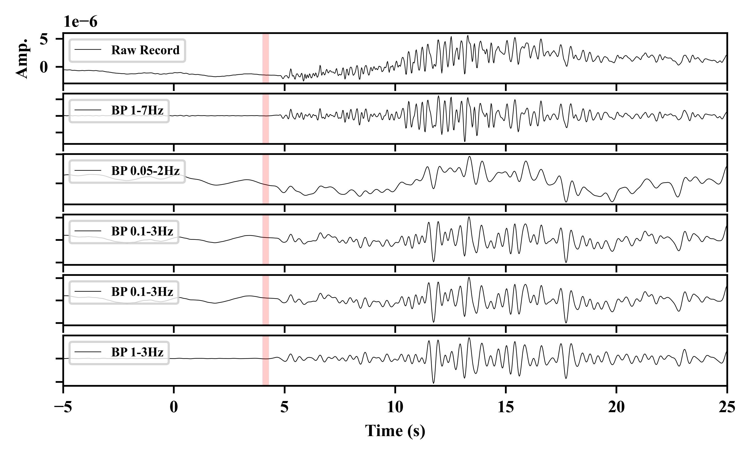
Mass Download Waveform and Data Preprocessing
Remove the instrument response
source
Resample and filter waveforms
Mark the P-wave traveltime on waveforms
Select waveforms according to signal-to-noise ratio

Slide 11
Mass Download Waveform and Data Preprocessing
Taup Tookit
Remove the instrument response
Resample and filter waveforms
Mark the P-wave traveltime on waveforms
Select waveforms according to signal-to-noise ratio

Slide 12
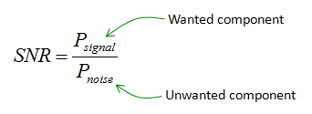
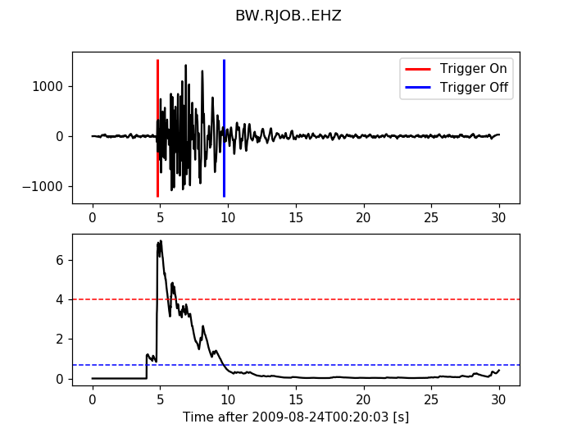
Mass Download Waveform and Data Preprocessing
Remove the instrument response
Resample and filter waveforms
Mark the P-wave traveltime on waveforms
Select waveforms according to signal-to-noise ratio

Slide 13
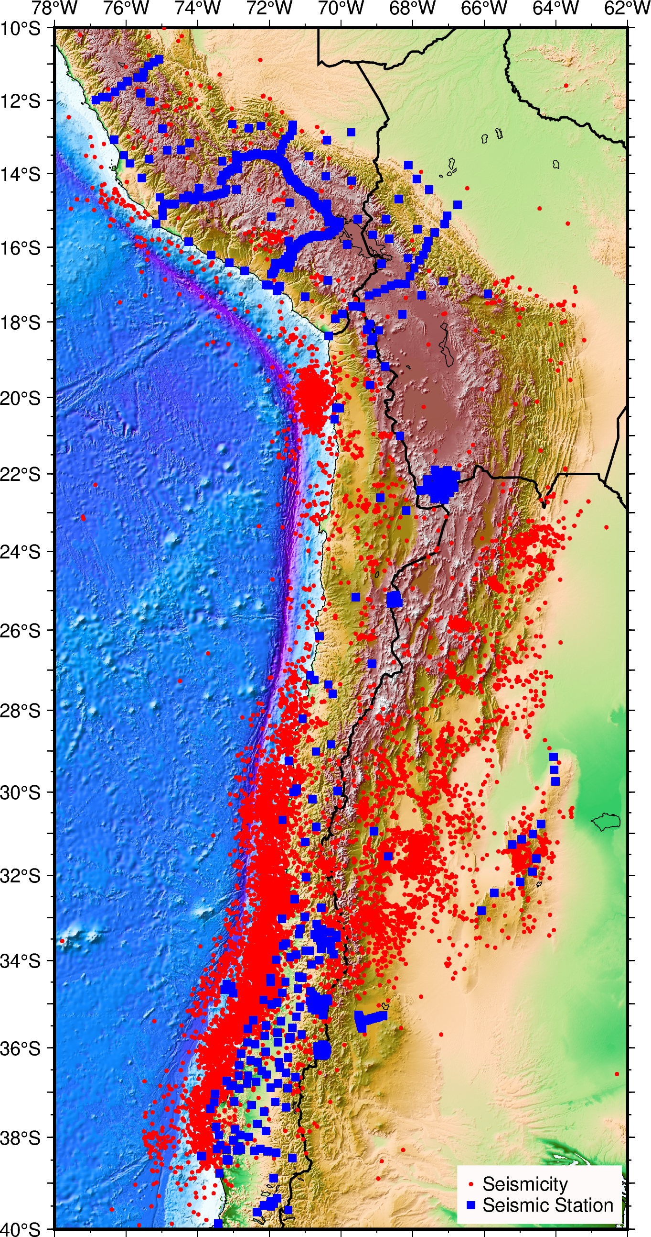
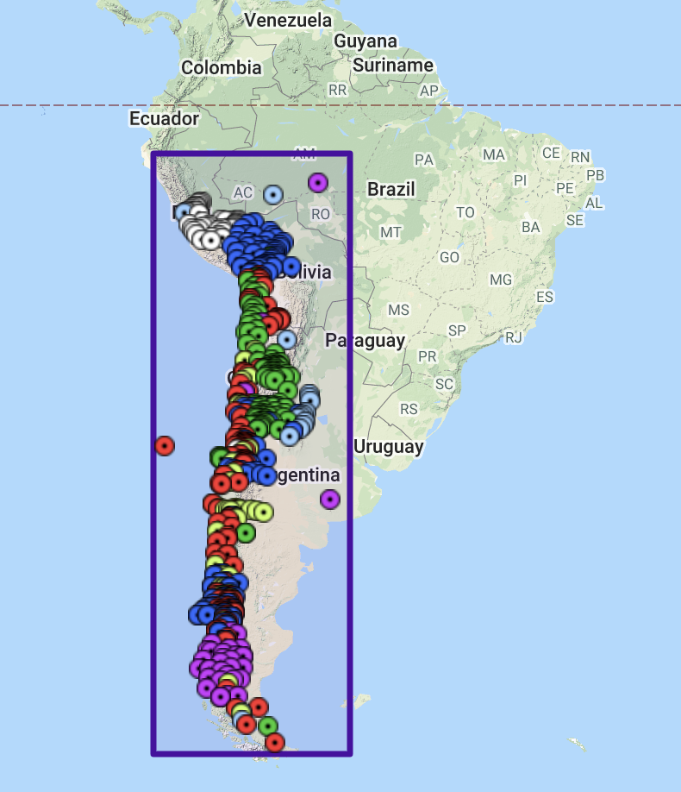
Mass Download Waveform and Data Preprocessing
2010-01-01 ~ 2020-01-01
1
2
3
source
4

